Slide 1
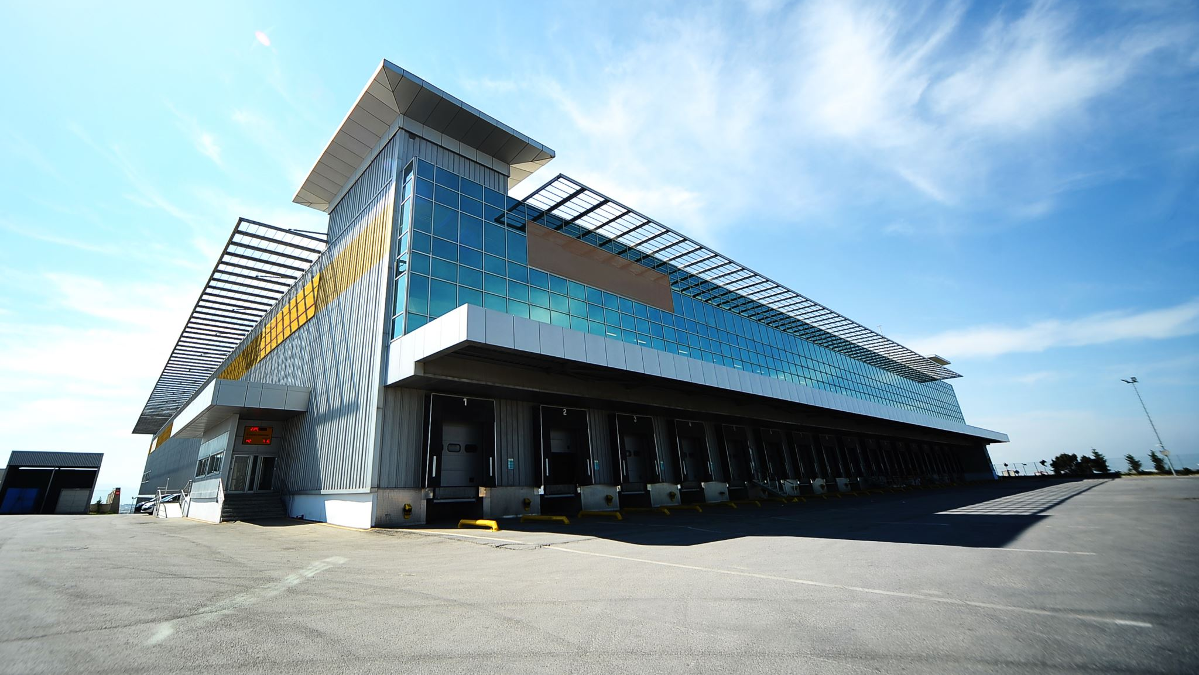
AMAP SHOPPING CENTER
MOODBOARDS
Notes:
This is the mood board for AMAP shopping centre digital sign.

Slide 2
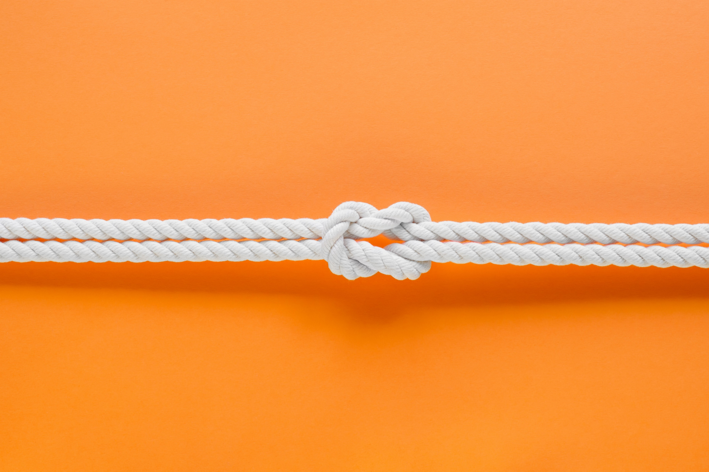
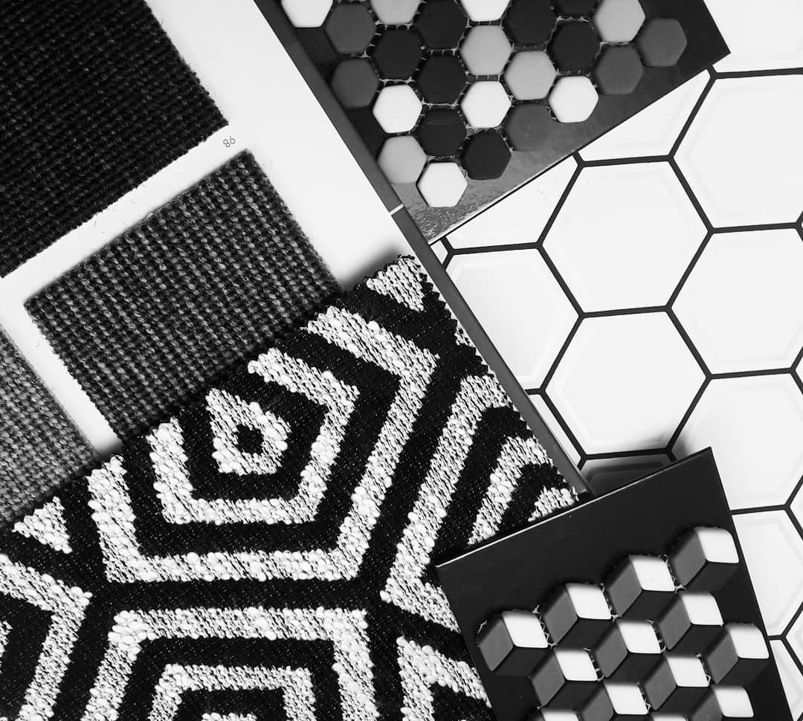

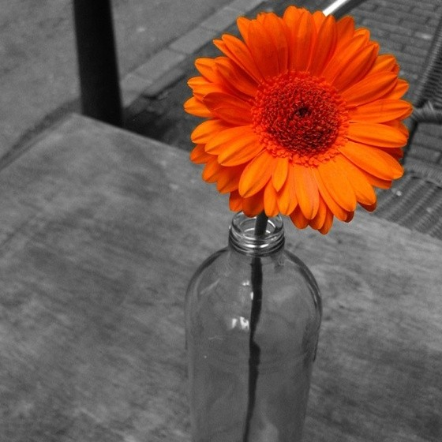

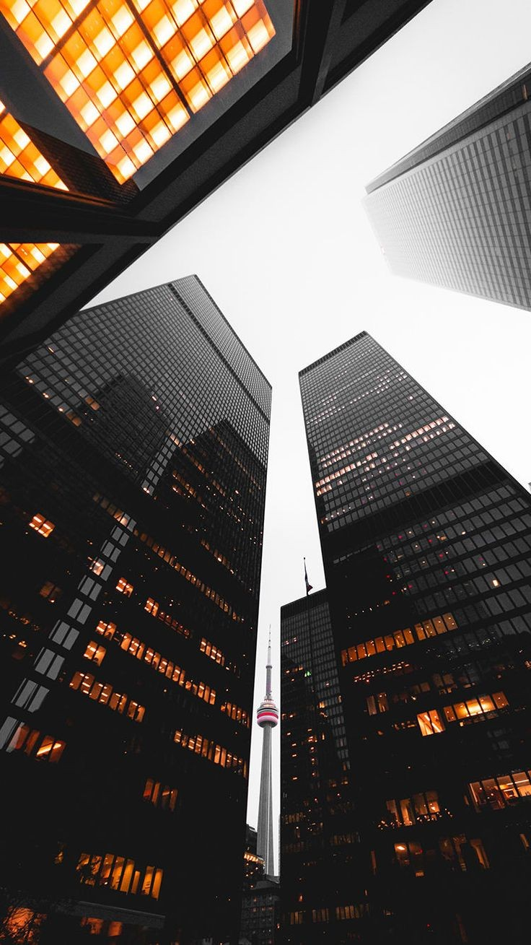

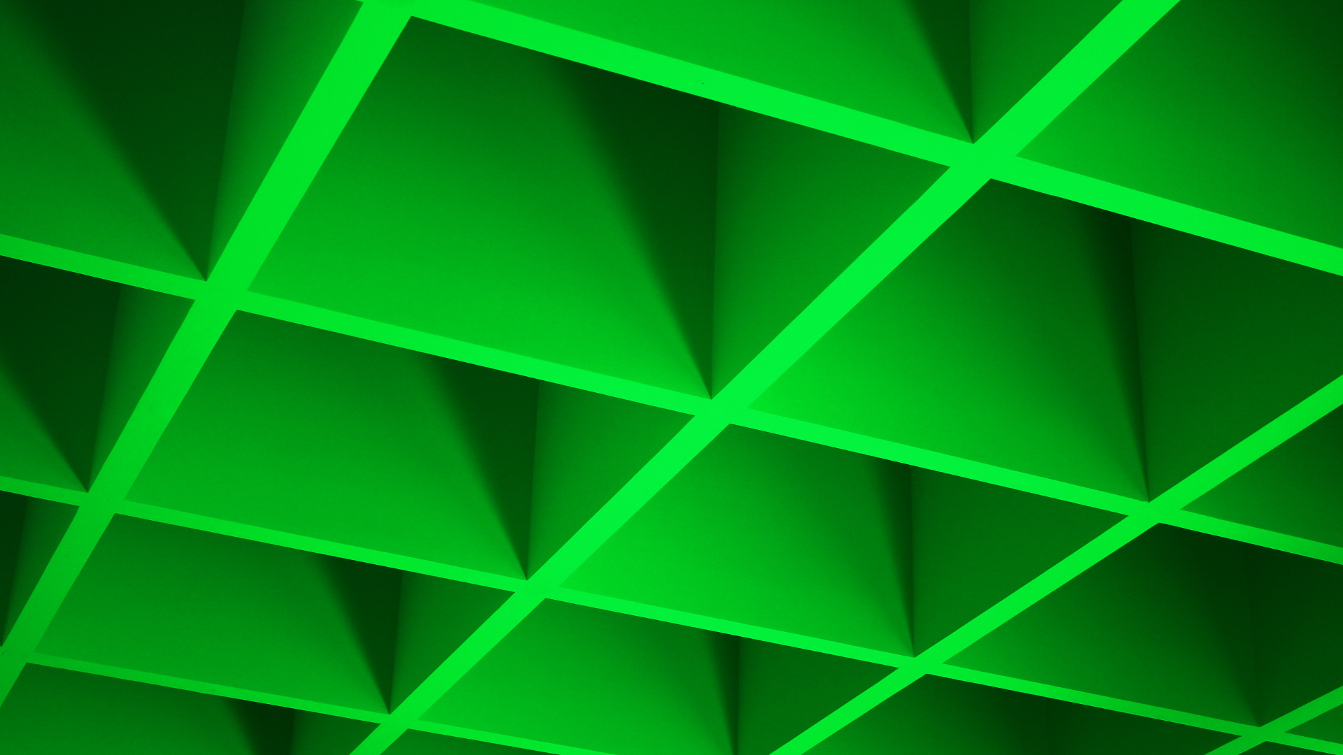
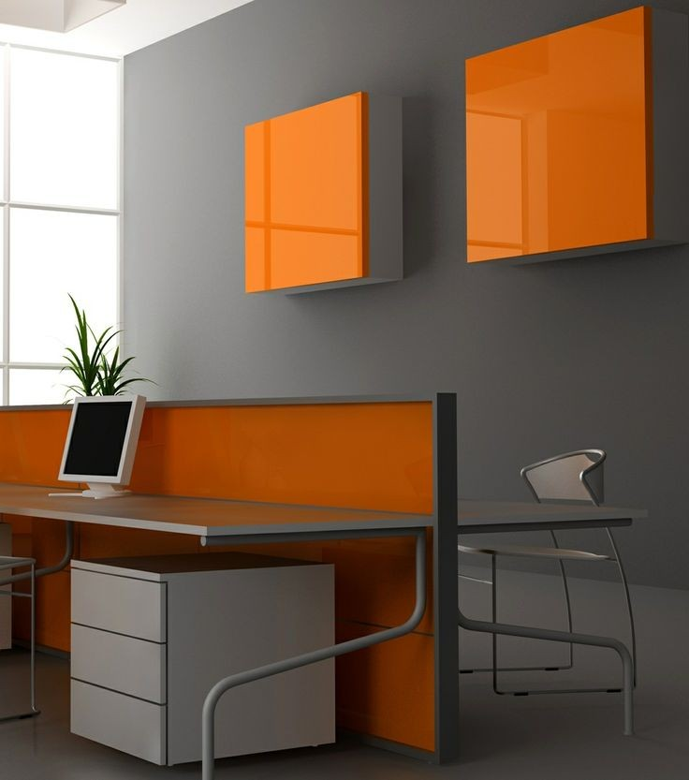
This Photo by Unknown Author is licensed under CC BY-SA
Notes:
The digital sign will have shades of lighter grey and bright orange. The colour green will be used to validate choices. The reason why we avoided using pure white and pitch-black backgrounds were because the former would cause eye strain on the users since the level of brightness cannot be customized and the latter would not look presentable on the shopping centre in a thematic sense as it is colourful and vibrant.
Precisely, the hex code for the background that we will be using is #E8E6E6 (grey); #10BD10 (green) for hover effect; #FE5900 (orange) for buttons and black fonts for texts.
The choice for these colours were inspired by one of the Schneidermann’s principle that studies human behaviour to differentiate foreground and background like YouTube’s red and white logo or Facebook’s blue and white logo. The mood board also gave me the impression that these colour would be able to form uniformity together though it was risk I decided to take.
Usually, digital signs have bright backgrounds. But with grey background, there are two ways to make sure that the digital sign is pinpointable:
We can use displays that are bright and easier to notice even in the crowds like billboards. For example, whenever the digital sign is not being used for more than 10 seconds, it displays adverts on the screen.
We can use brighter colours like yellow or green that stands out and radiates familiarity rather than animosity like red on the actual digital sign hardware.

Slide 3
AMAP SHOPPING CENTER
This Photo by Unknown Author is licensed under CC BY-SA
Notes:
This is a second template of the same colour scheme but with a different layouts and grids.

